Slide 1


Space, Ensembles, and Oscillations
Stephen Cowen, PhD
Notes:
Advice- wait to prepare until you are here.

Slide 2
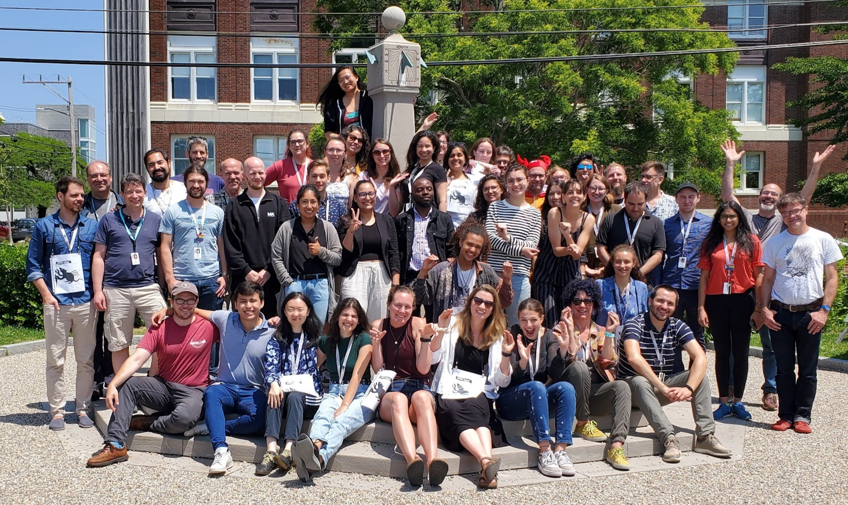

Slide 3


Slide 4

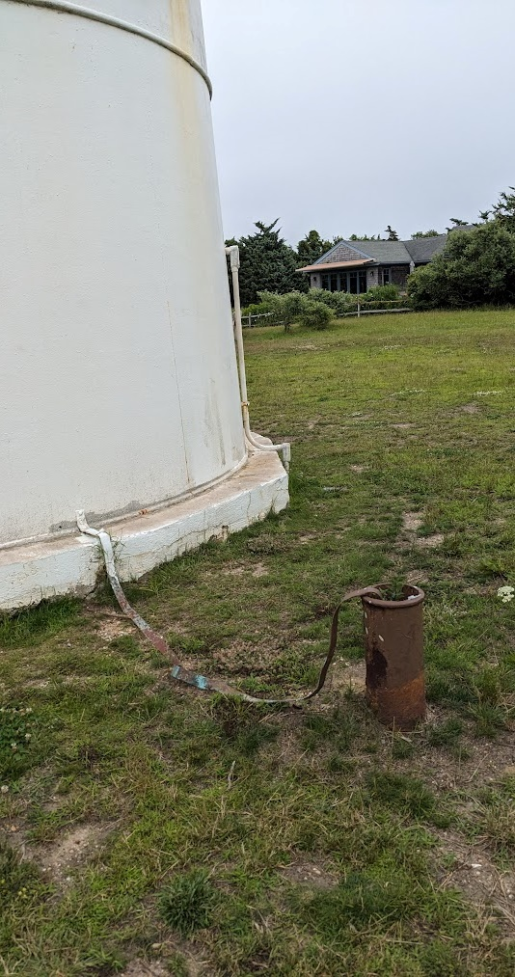
Martha’s lesson for neurophysiologists…

Slide 5
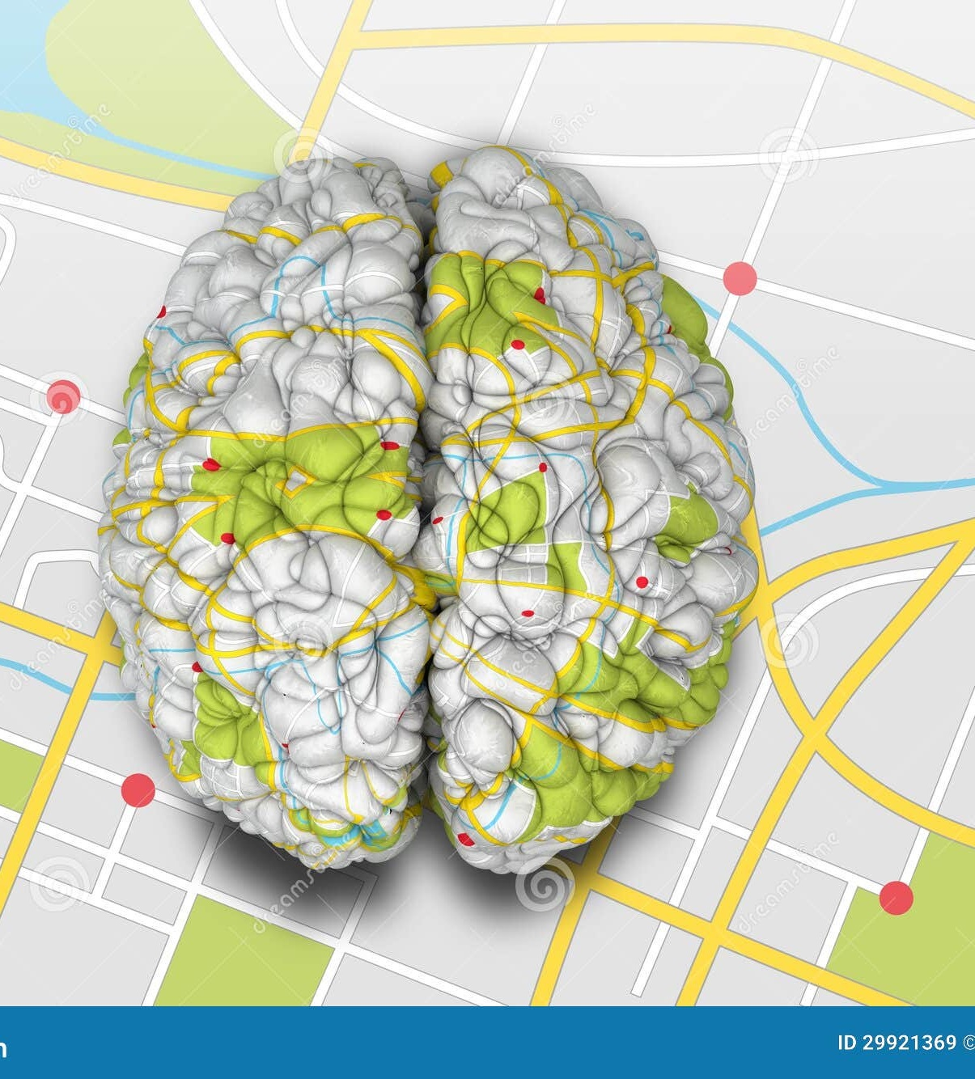

Roadmap
From Neurons…
Reverberant circuits do things: Cajal, de No, Hebb
Single-unit activity in the hippocampus, episodic, and spatial memory.
Age-associated changes in coding for space.
To Oscillations…
How to measure them: Fourier
Gamma, ketamine, dyskinesia
Notes:
How do individual and groups of neurons encode things.
(point to the picture- how do neurons encode spaces and maps)
Cell assembly: talk about ???
Oscillation: talk about ripples, theta, 80Hz.
What is a neural ensemble anyway?
Talked about arousal and vigilance states, modulators, decisions, actions, memories. Below this, we assume there is some system of representation in the brain that stores and allows transmission of that information. We call this the ensemble.
What is an oscillation?
Pick up where Matt, Nic, Jess, Quentin were – and perhaps even go a little more basic to explore and explain oscillations.
Modulated by speed – point to Quentin – cortex – not all oscillations
Does it require full body movement?
The big question of species? Not as clear in primates, not really associated with movement in bats.
What aren’t oscillations – but arguably just as interesting.
Focus on Theta.
Where do these ideas intersect?
Phase precession and phase coding in the hippocampus (theta ripples)

Slide 6
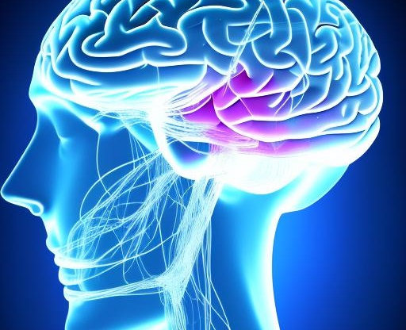
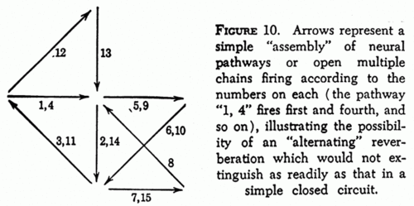
What is the language of thought and memory? Reverberant Circuits
Notes:
Many definitions, most are probably not wrong.
What is a thought?
We talked about arousal and vigilance states, modulators, actions memories.
Vague questions that are difficult to answer and generate uncomfortable pauses….
Make it somewhat more specific–
If you took a snapshot of a brain –say a fly or mouse brain- and had all of the synaptic weights, neuromodulator levels, would that be enough to identify a brain state?
Is the fundamental information bearing unit in the brain the action potential? A synaptic depolarization? The coordinated action of many neurons

Slide 7
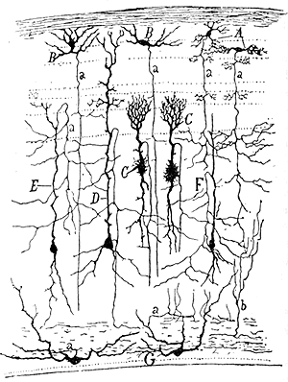
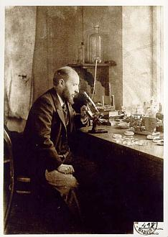
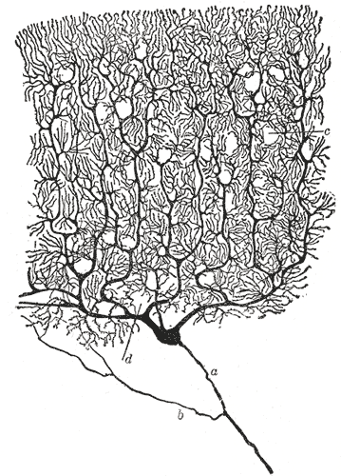
Santiago Ramón y Cajal
Cajal: The nervous system is made up of separate, identifiable cells. The neuron doctrine (~1900)
Notes:
The identification of neurons (Figure 1.4) as separate cells by the Spanish neuroanatomist Santiago
Ramón y Cajal ( 1 May 1852 – 18 October 1934) in the decades just before the turn of the twentieth century was a major turning point. This finding implied that cognitive processes are carried out by large populations of neurons.
Golgi (the guy in the upper left corner) invented the stain, but never believed that neurons were separate from each other. Believe in reticular theory (all one single web). He was wrong and hated Cajal. Cajal was right – neurons are individual cells, but he still believed that they were connected. Cajal was not a big fan of Golgi either.
?Who started the neuron doctrine?
?Who invented the stain?

Slide 8
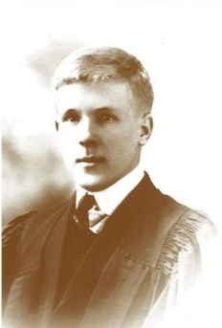
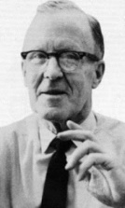
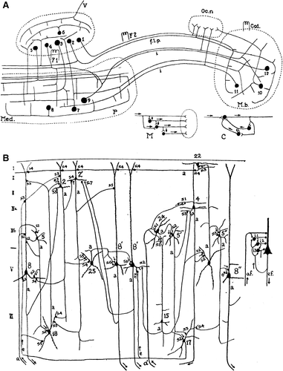
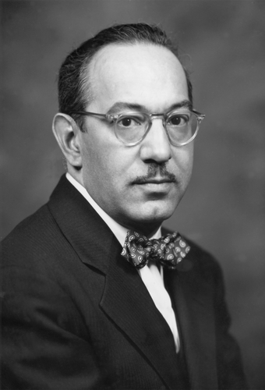

Slide 9

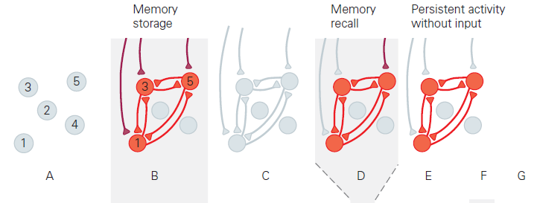
Notes:
Ask students where this came from… Kandel and Schwartz
But this was not really in line with hebb’s ideas – not at all. He was all about sequeqnces. Sequences make sense for many thing. Motor control, pattern generators, episodic memory. But perhaps not so much for so much more- odor memory. Context memory perhaps. Not even – at least at high frequencies in the fly, this can be done by some very clever mechanical amplification.
How would you determine if the sequence or the reverberation is necessary…

Slide 10
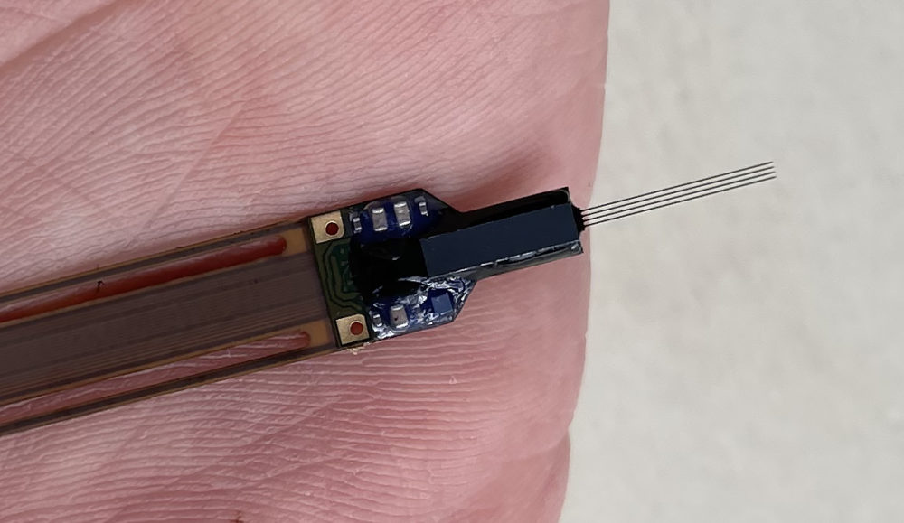
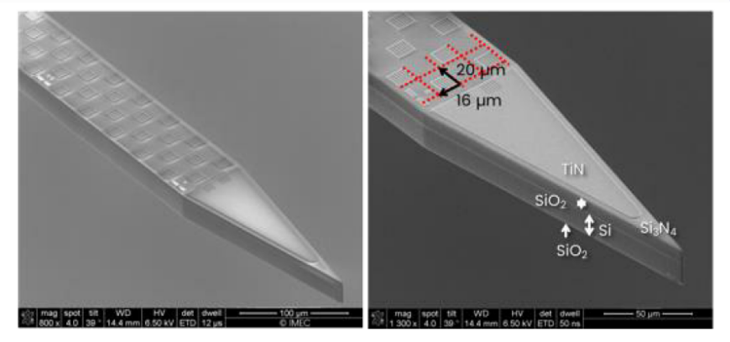

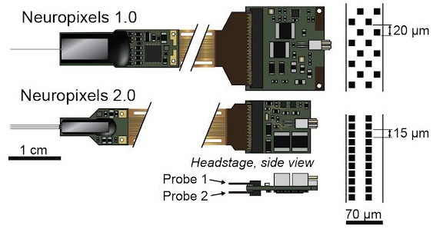

Slide 11
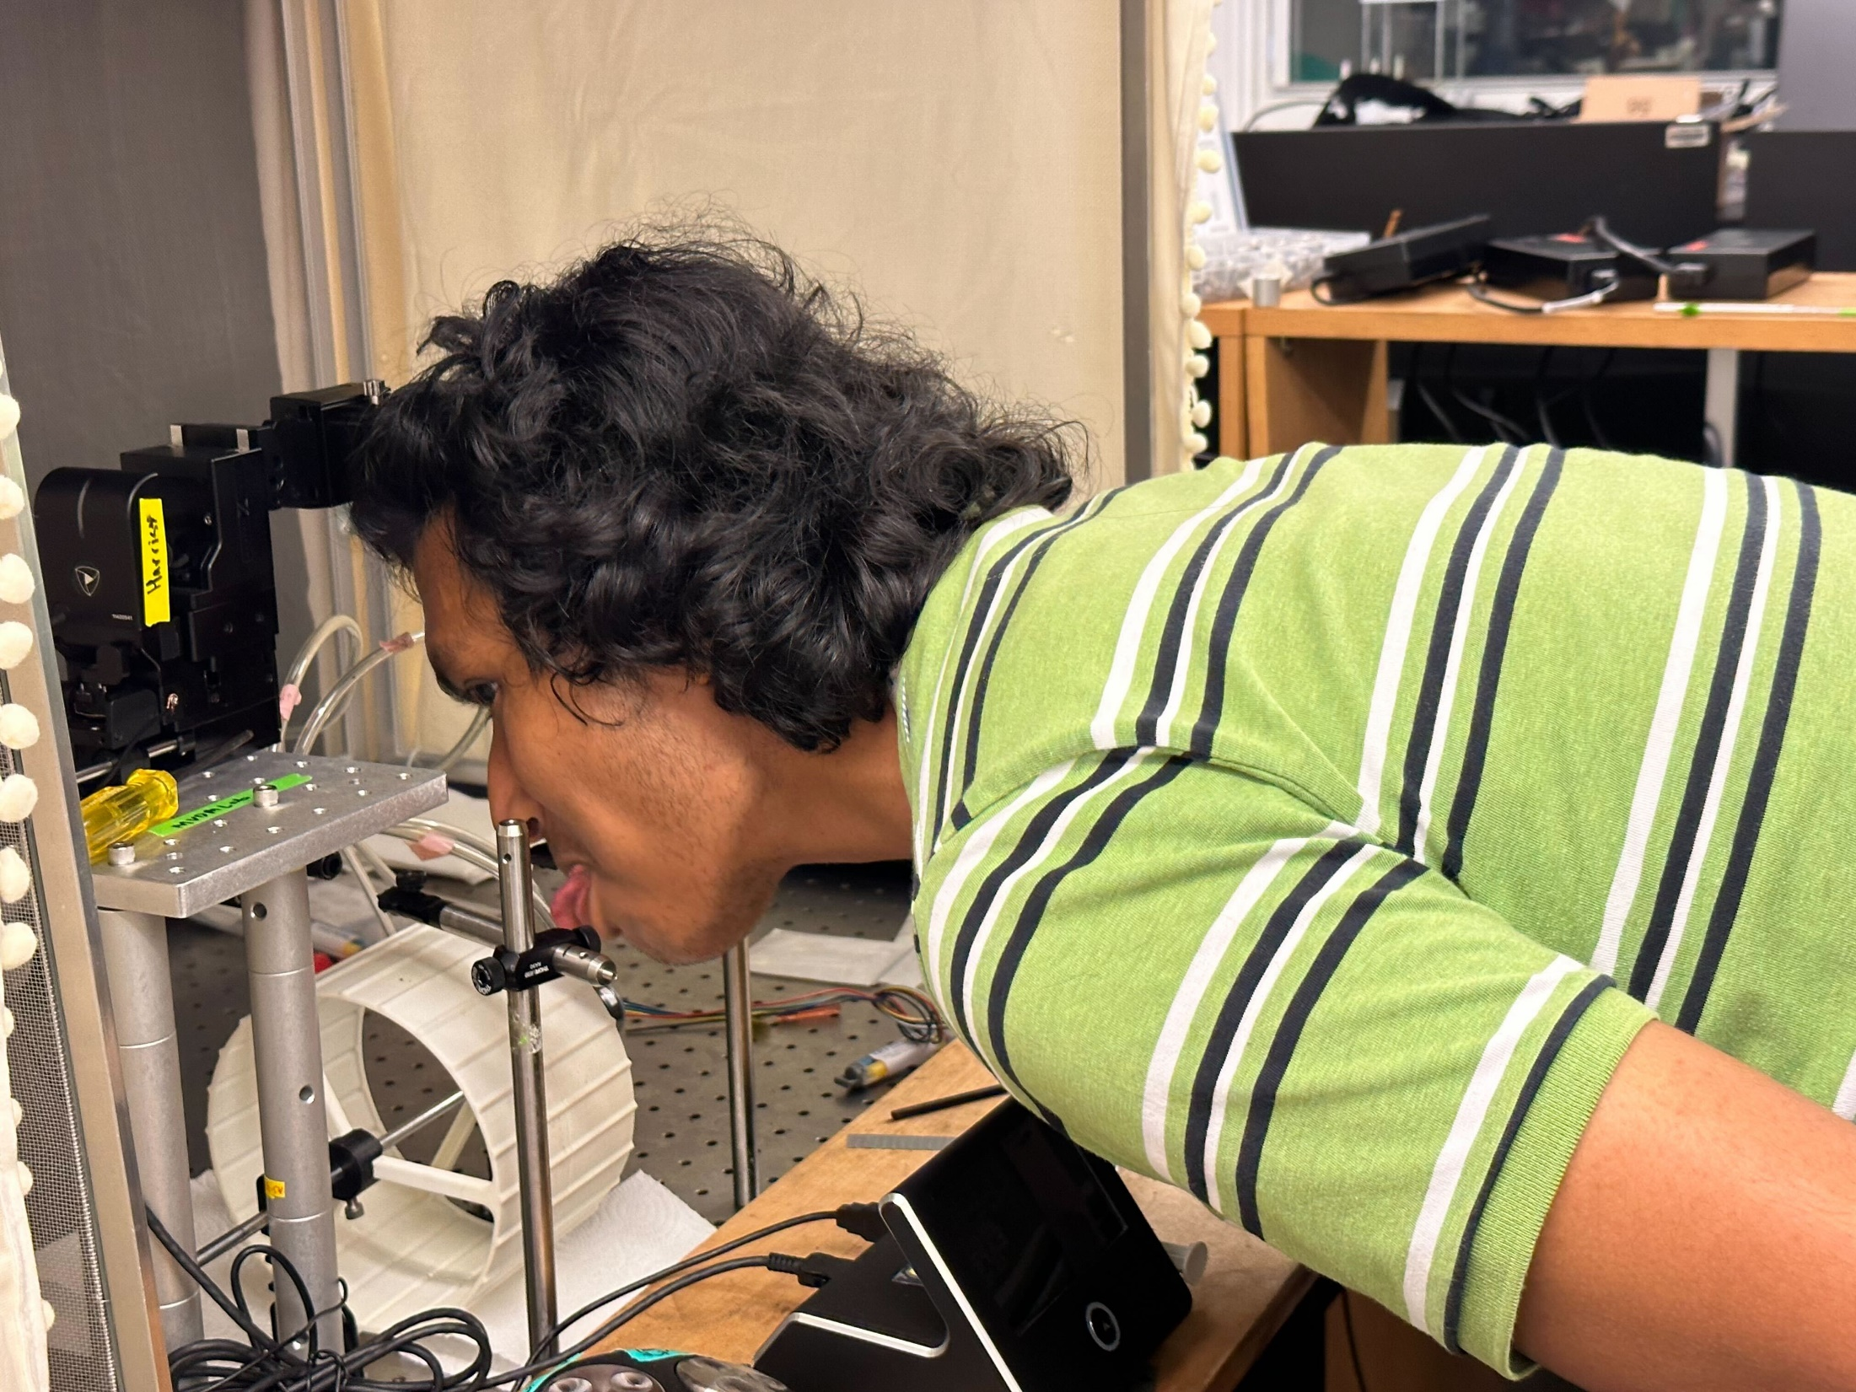

Slide 12
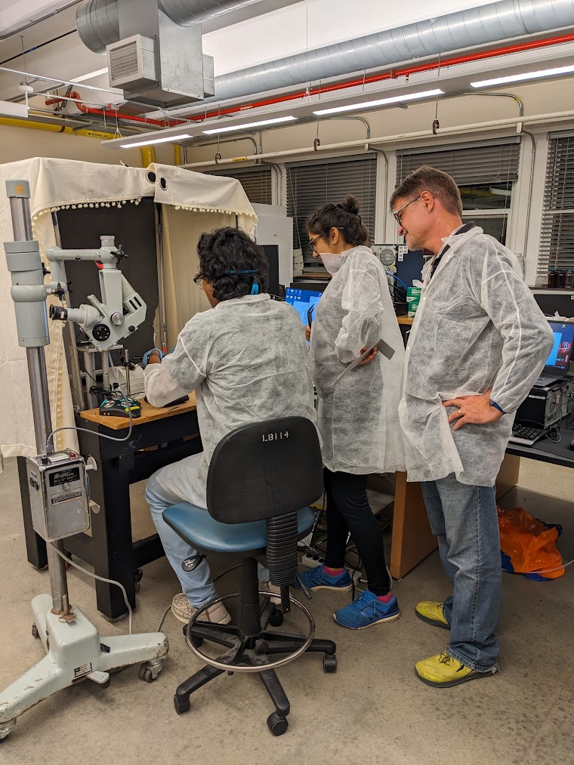

Slide 13
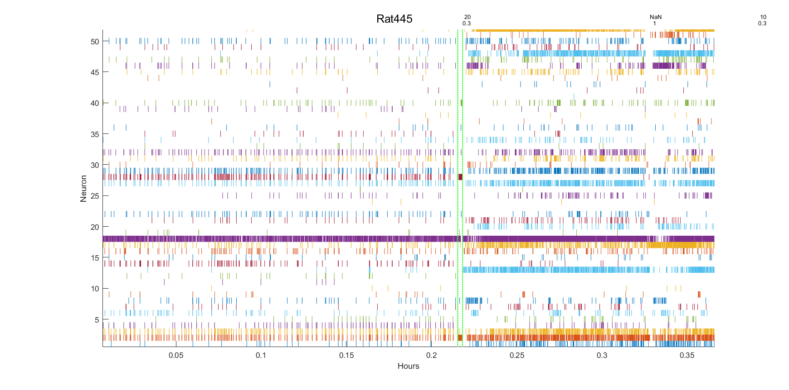

Slide 14
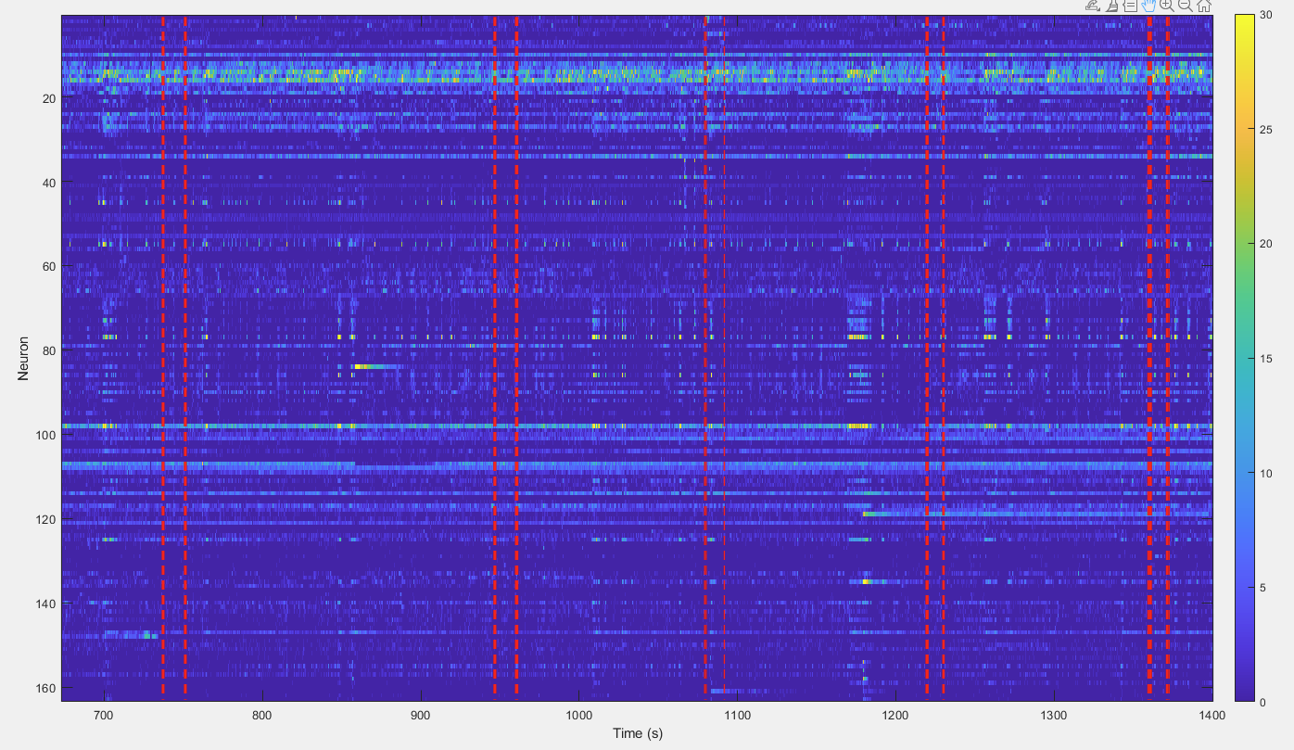

Slide 15
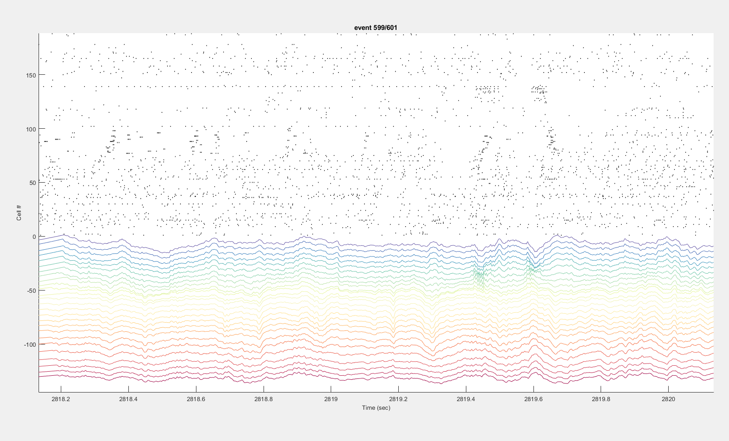

Slide 17
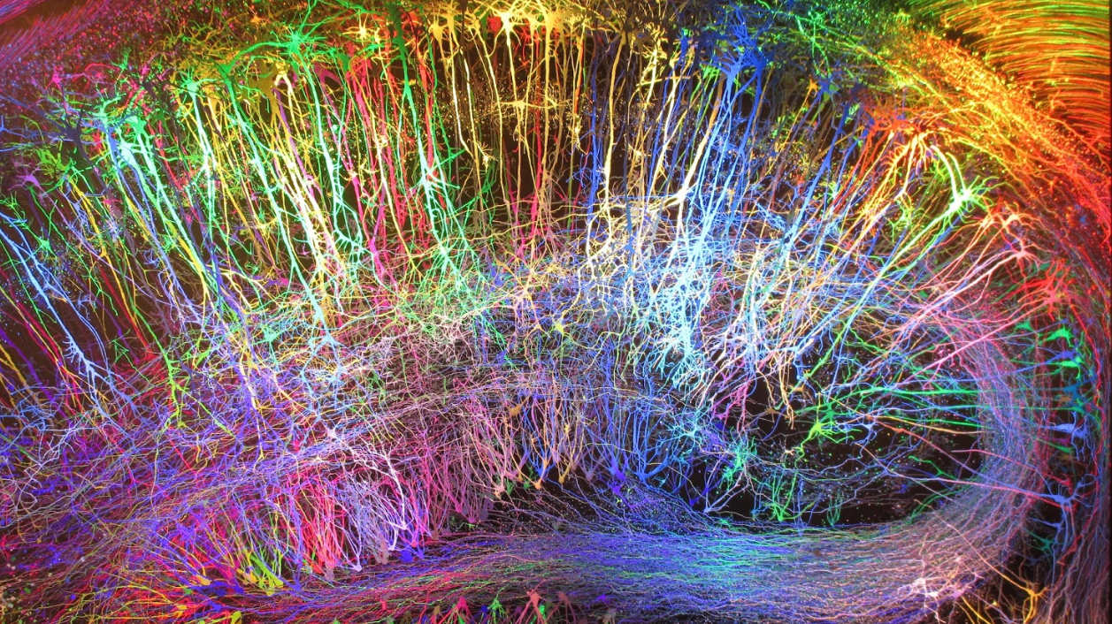
The Hippocampus and Cell Assemblies

Slide 18
If you plunked a Neuropixels probe in the hippocampus of a foraging rat, what is the first thing you would notice?
Art by Greg Dunn
Notes:
There are so many cellular, molecular and systems level fmri
Functional connectivity. One thing we would all like to know is how do these effects fundamentally affect the computations we thing the b rain
It’s a beautiful structure, but like all beautiful things, it get old. The older hippocampus has to do more with less. Reduced sensory input , potentially fewer aor altered synapses. Altered synaptic plasticity, …
What are the end consequences on the neural computations. Space and time.
How are the representations in the brain altered in the system.
Speed of processing. Inetegration of inputs.
integration
How much information about space
But – the map of space comes from the hippocampus integrating sensorimotor inputs: visual cues, vestibular cues, self-motion cues.
How are these processed by the aged rat?
Is this processing impaired?
To compute where you are in space you also need to inte
How much information is in the spike
Does aging impact the capacity of the hippocampus to process incoming ve

Slide 19

me
Place fields

Slide 20
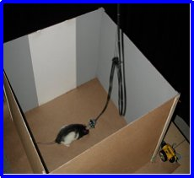
80 CA1 Place Fields (and interneurons)
Wilson McNaughton

Slide 21
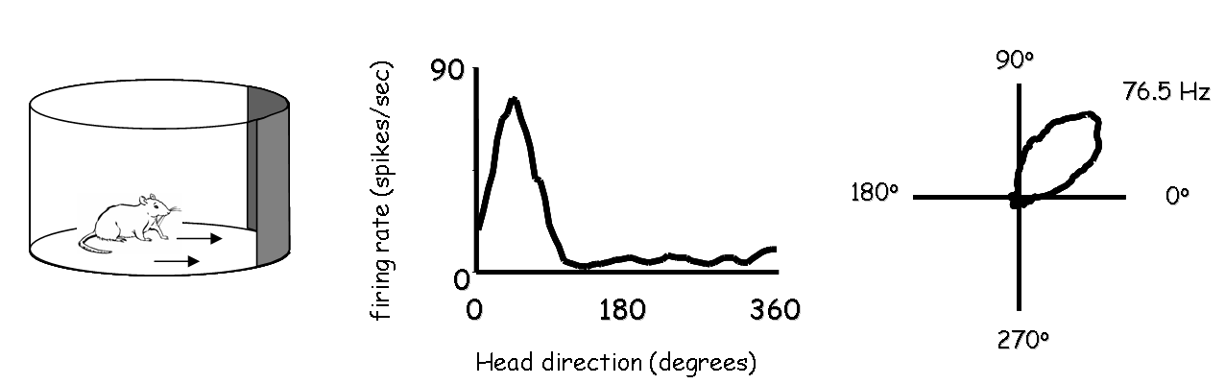
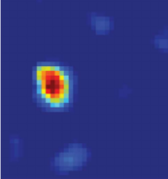
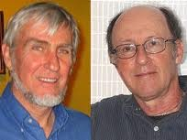
Brief history of high-order neural representations of memory and space
HD cell
HD cell
DISCOVERY: Hippocampal place cells in the 1970s (O’Keefe & Dostrovsky, 1971) and head-direction cells in the 1980s (Ranck, 1985; Taube et al., 1990).
O’Keefe & Nadel, 1978 the hippocampus serves as a ‘map’ for space. They then linked this to episodic memory.
Fun Fact: Same year delay cells were observed in the primate (Fuster and Alexander, 1971; Kubota and Niki, 1971).
Big Deal: We can directly measure brain processes involved in higher-order representations and memories that were beyond simple stimulus-response associations.
Place field
Get their seminal book for free at… http://www.cognitivemap.net/

Slide 22
Place cells are a lie.
Notes:
Why are place fields a lie?

Slide 23
“Place Cells” cannot be the whole story.
On principle alone:
Episodic memory requires more than place.
Navigation requires more than knowing where you are.
Decades of subsequent observations
Here are a few…

Slide 24

Time Fields in the HC

Slide 25
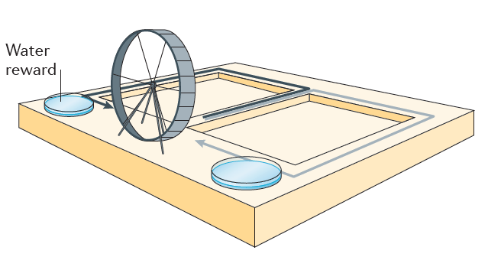
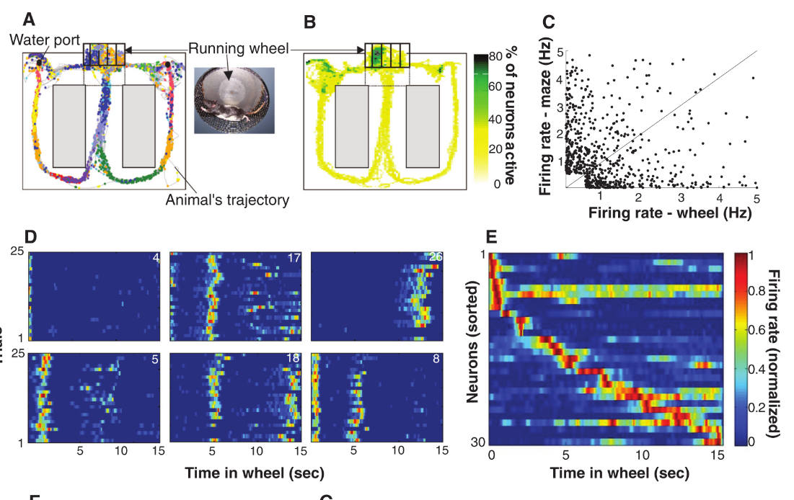
CA1/CA3 neurons encode TIME
Pastalkova, E., Itskov, V., Amarasingham, A., and Buzsáki, G. (2008). Internally generated cell assembly sequences in the rat hippocampus. Science 321, 1322–1327.
Notes:
Neurons in CA1 and CA3 have ‘time fields’ that only activate at certain times from the start of running in a running wheel (but ONLY if the task is sufficiently complex – as it does not work when the running wheel is in the home cage, but does work when it is on a working memory/goal directed task.

Slide 26
Repeating Fields in CA1: Chunking common experience.

Slide 27
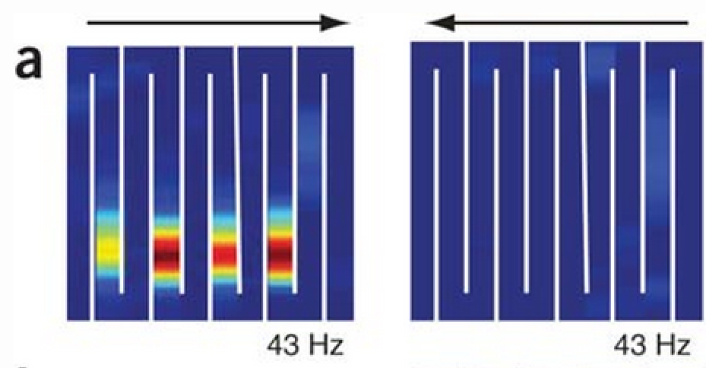
Similar environments: Place cells repeat themselves (but only after about 1 week of training)
Rats run on a twisty long ‘hairpin’ maze.
Derdikman D, Whitlock JR, Tsao A, Fyhn M, Hafting T, Moser MB, Moser EI. Fragmentation of grid cell maps in a multicompartment environment. Nat Neurosci. 2009;12:1325–1332. doi: 10.1038/nn.2396
Notes:
Generalize – not spatial. Would think that the rat would get more confused in the middle.
Semantic memory – what is it? After repeating memories with common elements.

Slide 28
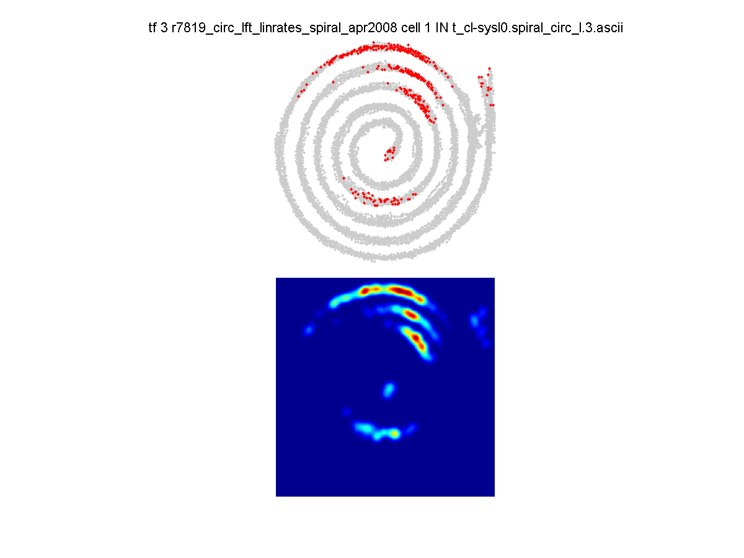
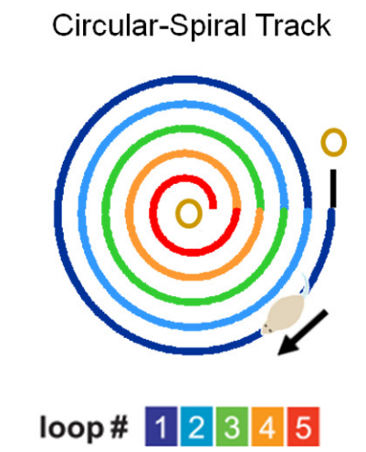
Field repeats on a spiral track
Cowen, S.L., and Nitz, D.A. (2014). Repeating Firing Fields of CA1 Neurons Shift Forward in Response to Increasing Angular Velocity. J. Neurosci. 34, 232–241.
Notes:
Nitz D a (2011) Path shape impacts the extent of CA1 pattern recurrence both within and across environments. Journal of neurophysiology Available at: http://www.ncbi.nlm.nih.gov/pubmed/21289139 [Accessed April 12, 2011].
70% of cells
Fields longest on the outermost – about 2x longer as predicted on a concentric circle. Something to do – theta definition of field size.
Fields tend to be on the inner loops – common segments. = mark common segments.
Most similarity with trajectory. - - violates the simple directionality rule….
Mention grid cells – where would they reset. Confusing.

Slide 29
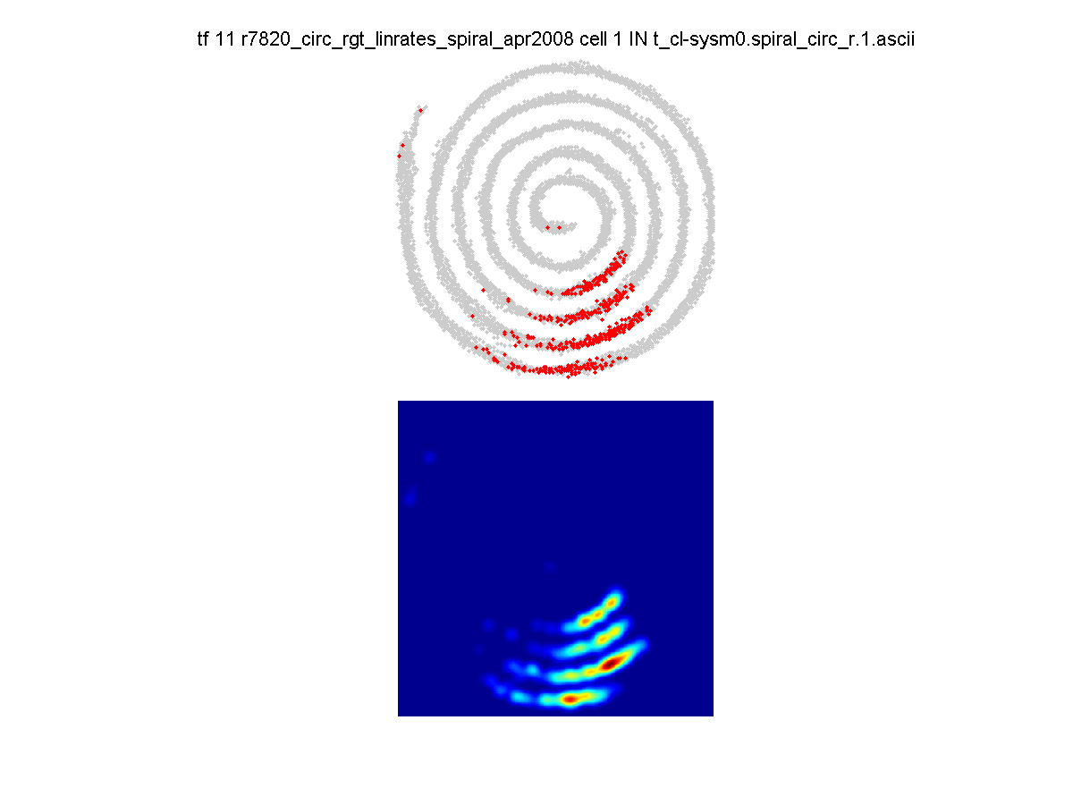
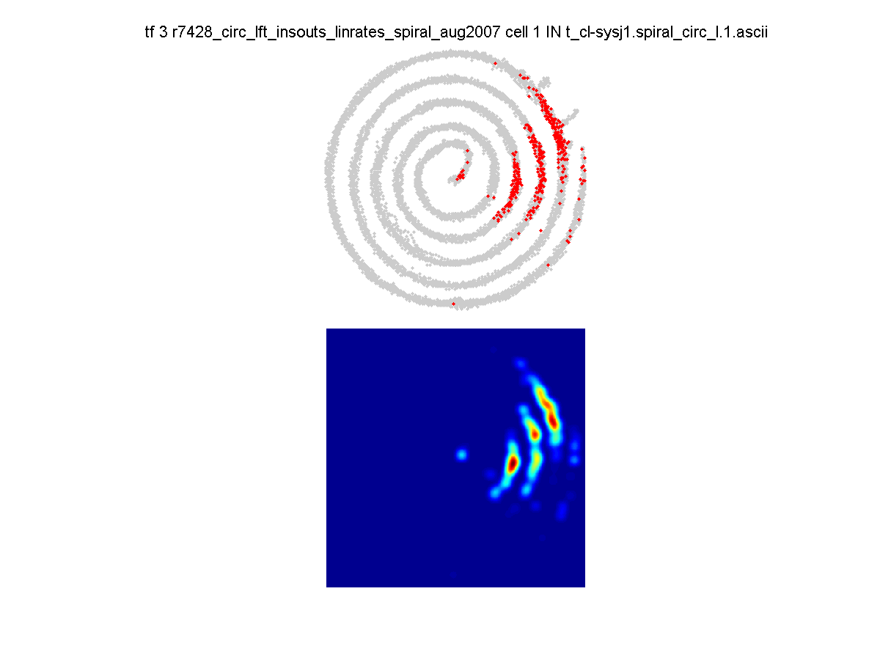
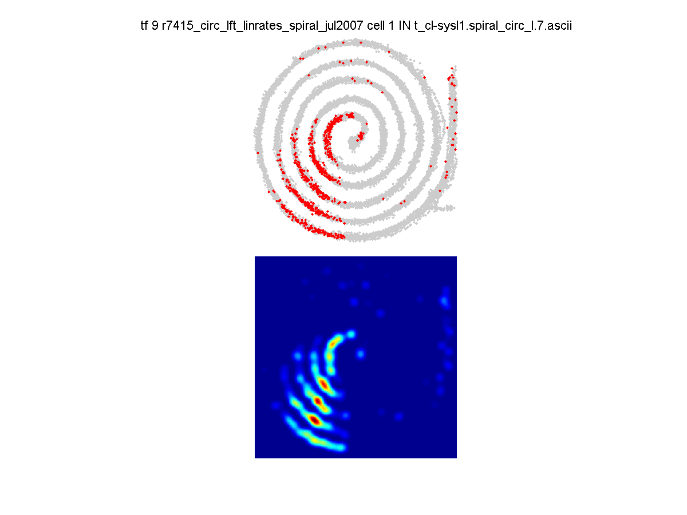
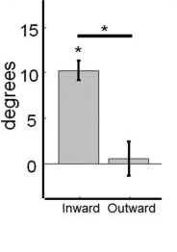
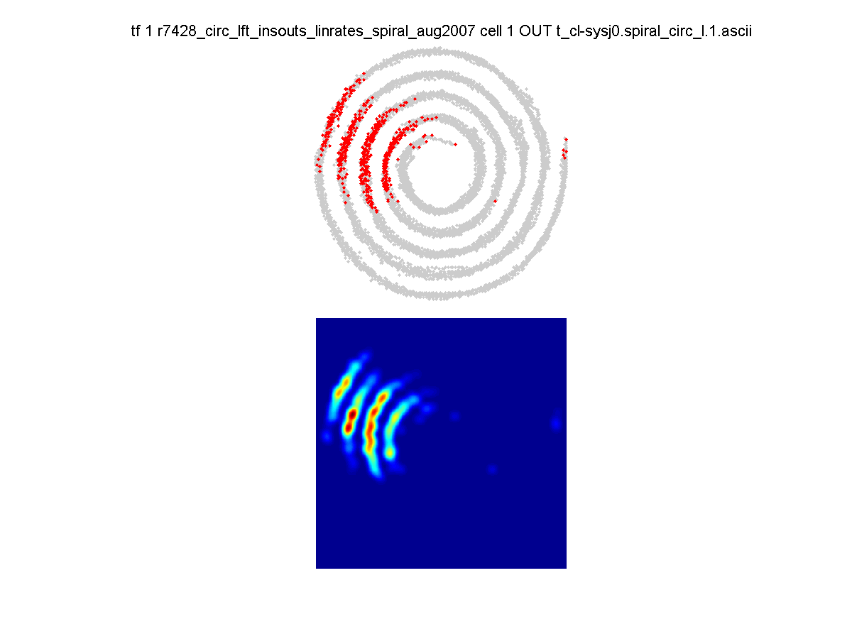

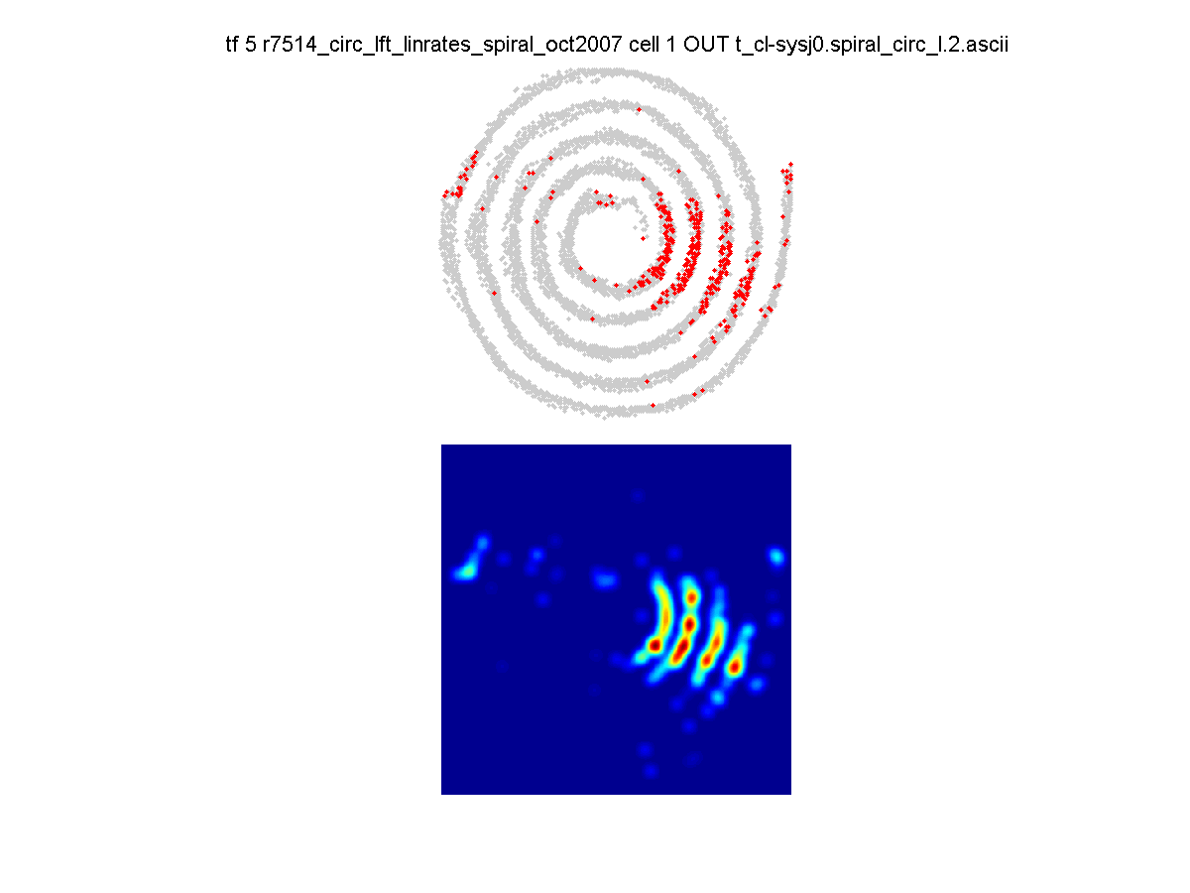
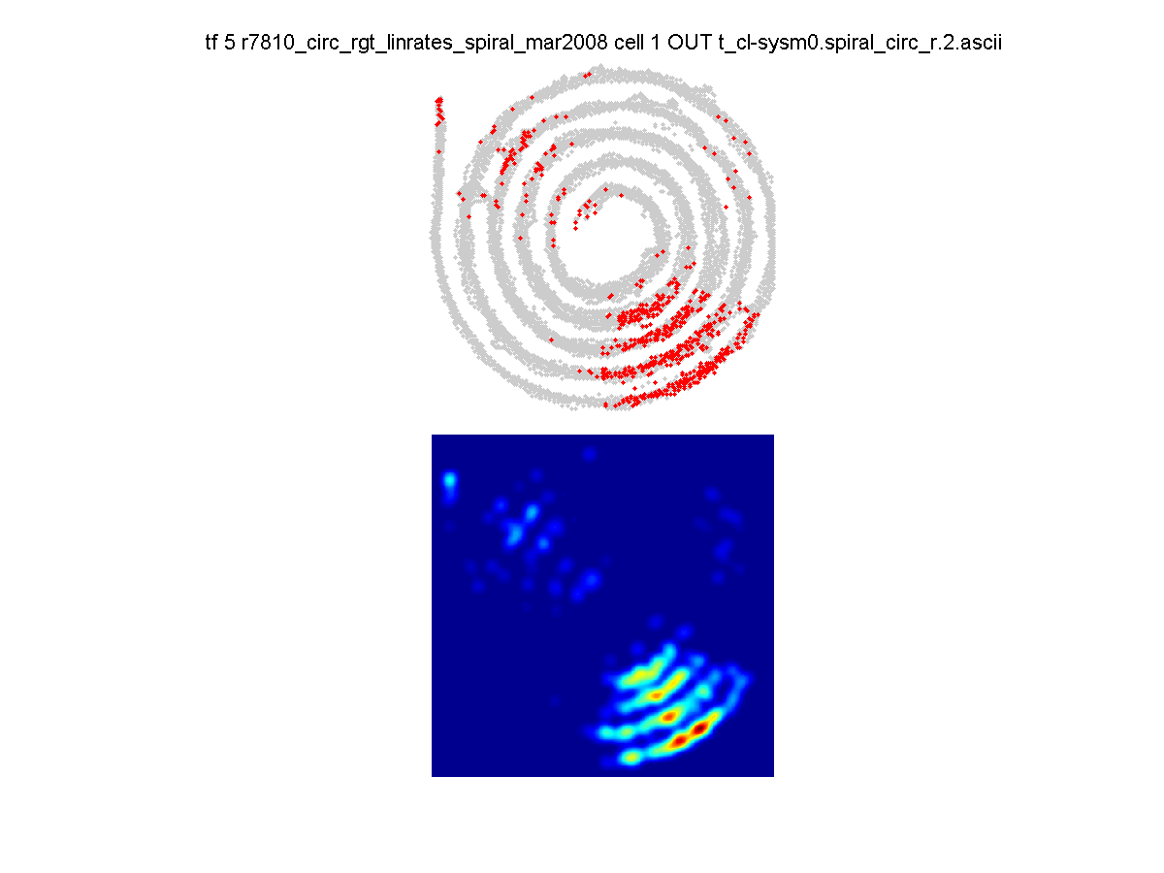
Inward:
Cell 1
2
3
4
Outward:
5
6
7
8
Cowen SL, Nitz DA. Repeating Firing Fields of CA1 Neurons Shift Forward in Response to Increasing Angular Velocity. The Journal of neuroscience 2014;34: 232–41. doi:10.1523/JNEUROSCI.1199-13.2014
Notes:
29
Figure 3: Examples of the forward shift of the center of mass of neurons during inward but not outward journeys. A) Spiking responses (red dots) and the accompanying place-field density plots are presented for four neurons recorded as animals either traveled towards the center of the circular spiral track (Figure 1A). B) Same as in A, but for outward journeys.

Slide 30
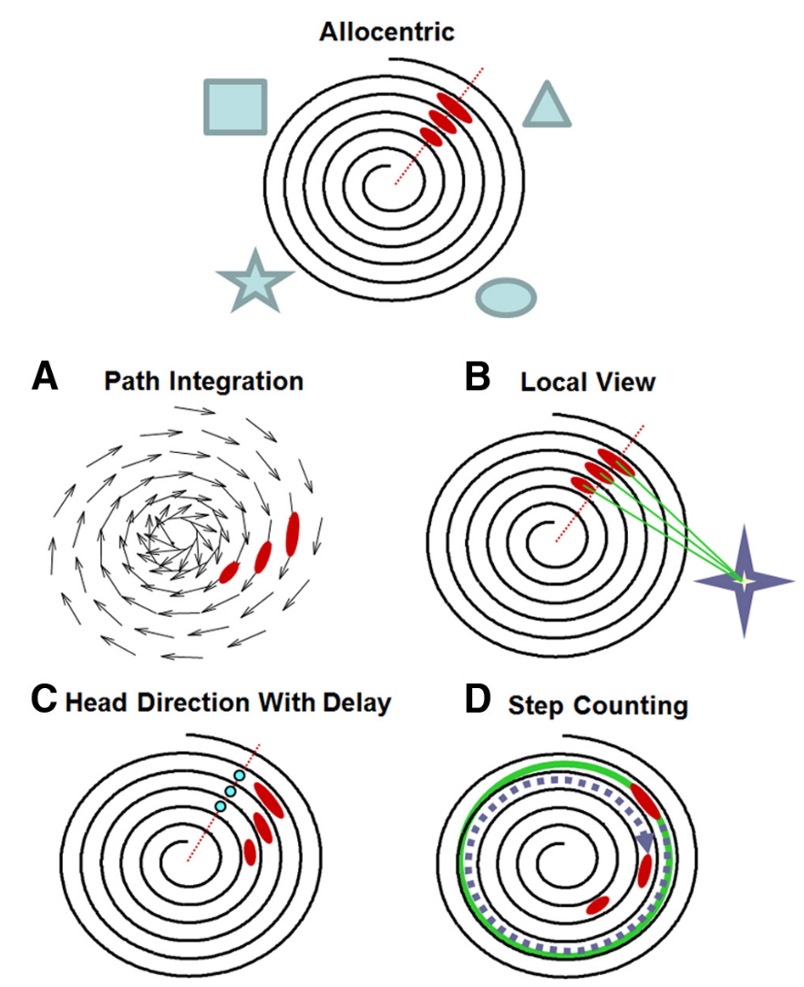

Slide 31
How does aging alter neural representations of space and motion?
Art by Greg Dunn
Notes:
There are so many cellular, molecular and systems level fmri
Functional connectivity. One thing we would all like to know is how do these effects fundamentally affect the computations we thing the b rain
It’s a beautiful structure, but like all beautiful things, it get old. The older hippocampus has to do more with less. Reduced sensory input , potentially fewer aor altered synapses. Altered synaptic plasticity, …
What are the end consequences on the neural computations. Space and time.
How are the representations in the brain altered in the system.
Speed of processing. Inetegration of inputs.
integration
How much information about space
But – the map of space comes from the hippocampus integrating sensorimotor inputs: visual cues, vestibular cues, self-motion cues.
How are these processed by the aged rat?
Is this processing impaired?
To compute where you are in space you also need to inte
How much information is in the spike
Does aging impact the capacity of the hippocampus to process incoming ve

Slide 32





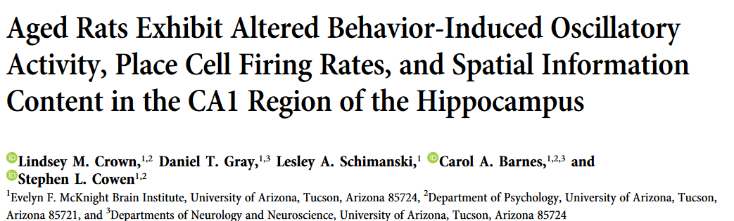
Lindsey Crown, PhD

Slide 33
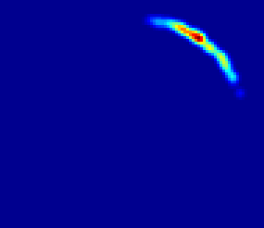
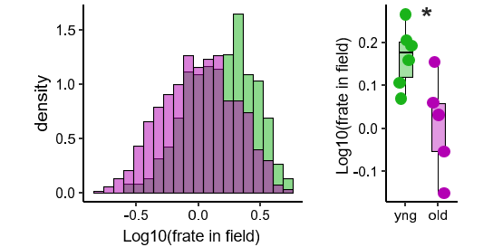
Are CA1 principal cells more ‘precise’ in responding to spatial information?
In field vs out of field
Rat speed:
> 4cm/sec <= 40cm/sec
In field
Young
Aged
P<1e-7
P<0.02

Slide 34
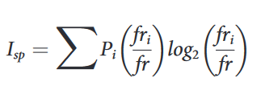
How much information about space is available per action potential?
The within-field rate is lower in aged rats
Young
Aged
Position

Slide 35
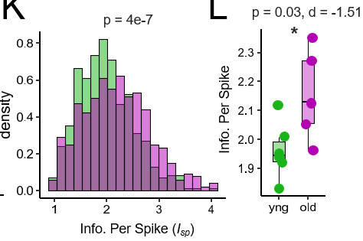
Young
Aged
The information per spike is greater in the aged rats.

Slide 36
Summary
Aging does not alter average firing rates in the hippocampus but…
Within-field activity decreases.
Yet, information per action potential increases.
The potential good news…
Aging does not reduce the capacity of neurons to respond to spatial information. The information is still there.

Slide 37
Roadmap
What is a cell assembly?
From Cajal to Hebb, and modern views
Single-unit activity in the hippocampus, episodic memory, and spatial memory.
Age-associated changes in coding for space.
What is (and isn’t) an oscillation?
Fourier
Theta
Gamma
Spike-field interactions
Notes:
Cell assembly: talk about ???
Oscillation: talk about ripples, theta, 80Hz.
What is a neural ensemble anyway?
Talked about arousal and vigilance states, modulators, decisions, actions, memories. Below this, we assume there is some system of representation in the brain that stores and allows transmission of that information. We call this the ensemble.
What is an oscillation?
Pick up where Matt, Nic, Jess, Quentin were – and perhaps even go a little more basic to explore and explain oscillations.
Modulated by speed – point to Quentin – cortex – not all oscillations
Does it require full body movement?
The big question of species? Not as clear in primates, not really associated with movement in bats.
What aren’t oscillations – but arguably just as interesting.
Focus on Theta.
Where do these ideas intersect?
Phase precession and phase coding in the hippocampus (theta ripples)

Slide 38
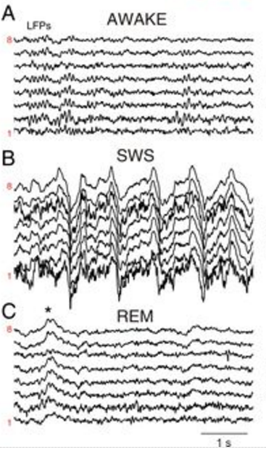
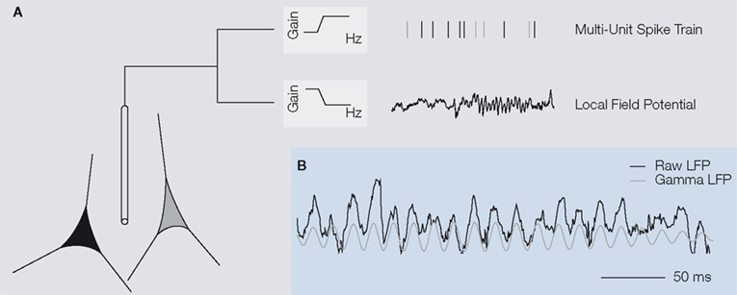
What is a local-field potential? (Why is this a bad choice of words?)
For low frequencies (< 50Hz roughly) it mostly represents the coordinated synaptic INPUT
For high frequencies (>50 Hz roughly) it may be a mix of action potentials and synaptic input
For very high frequencies (> 600Hz) it is thought to be exclusively action potentials
Notes:
Ask: Why is this a misnomer.

Slide 39
How do we identify and quantify oscillations embedded within the local field potential?

Slide 40
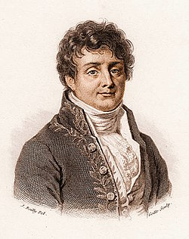
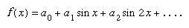
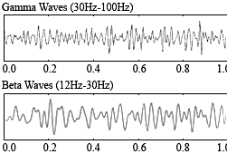
Fourier and his glorious transform
Any signal can be represented as a weighted series of sine waves of varying amplitude and phase. This is a very important concept.
Jean-Baptiste Joseph Fourier

Slide 41
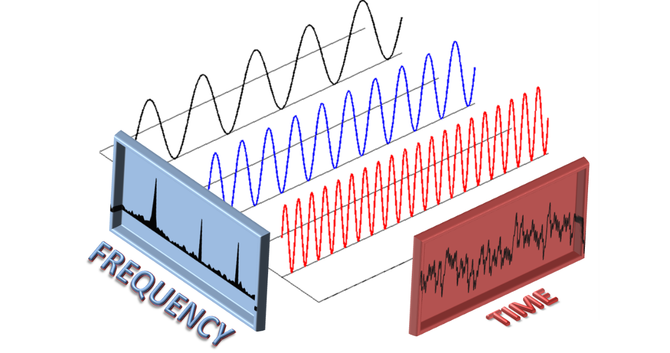

Slide 42

https://t1.daumcdn.net/cfile/tistory/99CC0F395AFEE81309

Slide 43

https://contra.medium.com/drawing-anything-with-fourier-series-using-blender-and-python-c0881e1b738c

Slide 44



Back to the brain: Hippocampal Theta Oscillations

Slide 45
me (again)
Theta

Slide 46



A
Left
Right
Lift
Advance
Grasp
Pull
Push
B
100 pixels
100 pixels
sec
500
n=6 rats
1
Lift
Advance
Grasp
Pull
Push
1.5
400
0.5
1
0.5
Wavelet Power (dB)
300
0
Frequency (Z score)
Power (Z score)
0
200
-0.5
-0.5
100
-1
-1
4
6
8
10
12
14
16
50
100
150
200
250
300
350
50
100
150
200
250
300
350
Hz
Phase (deg)
Phase (deg)

Slide 47

Gamma (in the hippocampus)

Slide 48



Spectral activity for a rat running on a track
Lindsey Crown, PhD

Slide 49



Parkinson’s Disease, dyskinesia, and fine-tuned gamma
dopamine

Slide 50

Notes:
Probably sleep deprived and very suggestible

Slide 51




Dopamine
Long term administration of Levodopa
Parkinson’s Motor Symptoms
LID Motor Symptoms
Our Animal Model: Inject a toxin (6-OHDA) that kills dopamine neurons in one hemisphere but leaves the other intact (control).
Ketamine
FDA approved for Depression
Reduces Dyskinesia behaviorally (Bartlett et al., 2020)

Slide 52







Dyskinetic Rat Given L-DOPA followed by Ketamine in a rat model of Parkinson’s disease
DA no DA
Movement
100
Lesioned Hemisphere (M1 motor cortex)
80
2
4
36
Hz
60
34
Bregma, AP 1.8mm
1
3
dB
40
32
20
30
28
100
Unlesioned Hemisphere (M1)
80
35
Hz
60
5
dB
40
30
20
25
100
L-DOPA
150
Ketamine
200
250
Dashed box: Pathological 80Hz. After ketamine, it goes away (for a bit)
Ketamine
L-DOPA Ketamine
M1
6
100
4
Std
2
Hz
60
0
-2
20
0
30
60
90
0
30
60
90
Minutes post-injection
Minutes post-injection
Notes:
A) Tetrode locations in M1. B) Beta oscillations observed in 6-OHDA lesioned hemisphere during circular treadmill walking. C) Movement (top) and spectral activity (bottom) in an LID animal (single session). Movement identified by tracking camera. Spectrograms for the lesioned (top) and unlesioned (bottom) hemispheres surrounding injection of L-DOPA and ketamine. Key: (1) clear beta prior to and shortly after L-DOPA (12 mg/kg). (2) 80-Hz γ activity 20-min after L-DOPA injection. (3) Ketamine (20 mg/kg) eliminates 80-Hz and triggers broad-band gamma. (4) 80-Hz re-emerges. (5) Unlesioned hemisphere shows focal 50-Hz γ.

Slide 53
Surprisingly few neurons phase lock to cortical 80Hz.

Slide 54

Mean overall firing rate
LID
Sham
L-DOPA
Ketamine
L-DOPA
Ketamine
0.02
15
Inertial measurement
speed
Inertial measurement
speed
0.01
5
***
***
***
***
*

Slide 55







My lab and graduates…
Abhilasha Vishwanath
Gabriel Holguin
Gabriel Winter
Gianna Jordan
Rajashree Ramamoorthy
Michelle Krumm
Dr. Lindsey Crown (Psych)
Dr. Tony Ye (Psych)
Parkinson’s disease…
Dr. Torsten Falk
Dr. Mitchell Bartlett
Dr. Julie Miller
Instrumentation and dopamine…
Dr. Michael Heien
Andrea Hamilton
Nathan Wientraub
Notes:
https://www.kgun9.com/news/local-news/ua-unveils-new-wildcat-sugar-skull-logo

